Slide 1
Additive Manufacturing The 3D Opportunity
Tim Messink
Anthony Meunier
Aseelah Muhammad
Team E
Notes:
Hello, my name is Anthony Meunier and in this portion of the presentation I will be focusing on the political and legal influences associated with additive manufacturing, followed by some important economic questions and considerations as they apply to the technology.

Slide 2
Introduction
Tim Messink
DeVry University
Team E
Notes:
Hello, my name is Tim Messink and we will begin with the introduction

Slide 3
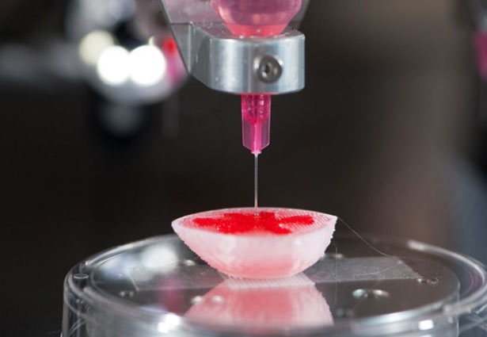
Introduction
Will additive manufacturing lead us into the next industrial revolution?
Notes:
TIM MESSINK
The term industrial revolution was used in the 19th century to characterize the trans-formative impact which technological developments had on the process of mass production.
In this presentation we will discuss the far-reaching implications of the additive process across many industries and related processes as well as economic, legal, environmental and ethical issues to support the argument that we are entering the third industrial revolution in the 21st century.
.

Slide 4
Brief Description of the Technology and Associated Science
Aseelah Muhammad
DeVry University
Team E

Slide 5
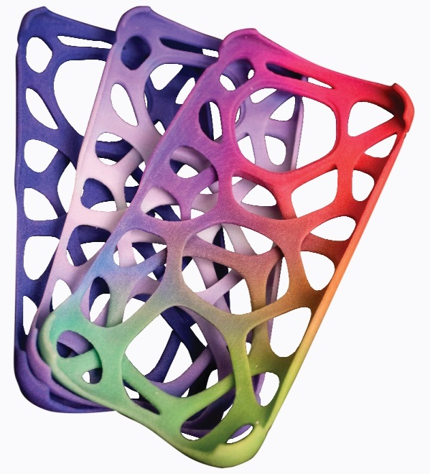
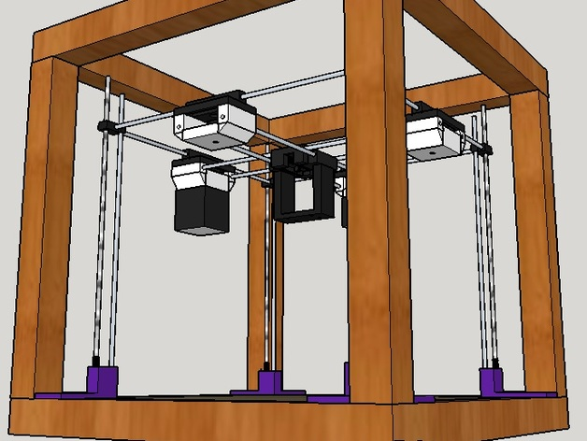
Brief Description of 3D printing and Additive Manufacturing
Notes:
The first commercial 3-D printer was invented by Charles Hull in 1986. A technique that heavily relies on lasers to solidify an ultraviolet-sensitive polymer material called stereo lithography was used. This technology was mostly unknown to the public until 2012.

Slide 6
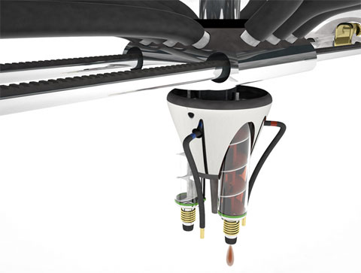
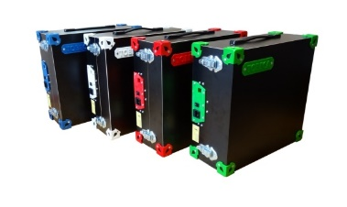
HOW DOES 3D PRINTING WORK?
WHAT IS 3D PRINTING USED FOR?
HEALTHCARE
SPORTS
AUTOMOTIVES
Notes:
A process of realizing virtual objects.
Rapid photo typing, distributed manufacturing, and custom manufacturing.
Can become feasible for home and small businesses.

Slide 7
Historical Development
Tim Messink
DeVry University
Team E
Notes:
Hello, my name is Tim Messink and in this portion of the presentation I will be focusing the historical development of concepts and its creators.

Slide 8
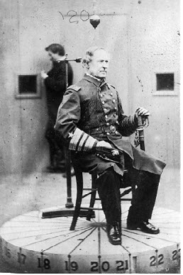
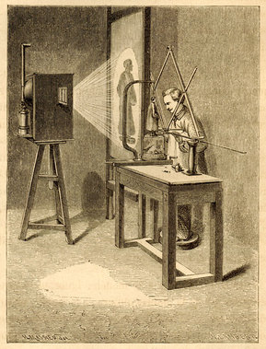
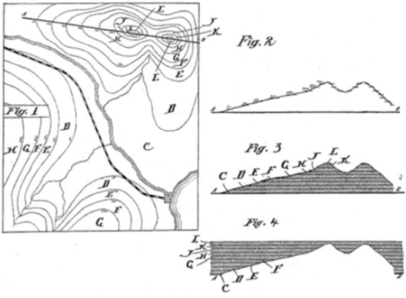
History
Francois Willeme, 1860 - photo-sculpting and a pantograph.
J.E. Blanther, 1892 – topography and the layering concept.
Notes:
The use of an additive manufacturing got its roots from photo-sculpturing and topography dating back to the middle of the 19th century.
In 1860 Francois Willeme using twenty-four cameras placed equally around the subject produced the silhouettes recreate a 3D likeness of the object using a pantograph.
Photo sculpting introduced the concept of layering and building a complete likeness of an object using the sum of the image profiles.
Later in 1892, J.E. Blanther, using contour lines of map images, cut a series of templates out of wax plates then stacking each layer to create a form of the raised map, introducing the concept of layering.
These two pioneers laid the foundation for the technoglies used today.

Slide 9
History of Additive Technologies
Rapid Prototyping is the driving force.
Charles Hull, 1986 - Stereolithography (SLA).
Joe Beaman, 1986 - Selective Laser Sintering (SLS).
Scott Crump, 1990 - Fused Deposition Modeling (FDM)
Dr. Gabor Forgacs, 1996 –
Professor Makoto Nakamura, 2008 -
}
Modern Day BIOPRINTING
Notes:
Throughout the 20th century, rapid prototyping was the driving force behind the evolution of 3D printing.
As Aseelah indicated Charles Hull was a true pioneer. In 1986 Charles Hull patented the concept of a prototype printing using a process called Stereolithography or SLA which was the first commercial rapid prototyping printing solid objects using layering based on a computer aided design (CAD) file.
The demand for a wider variety of materials to be used in the process like ceramics, nylon, glass and other metals such as aluminum and steel brought about Selective Laser Sintering or SLS guided by Carl Deckard. Deckard realized there was a tremendous market for an automated method to create complex casted parts. As a student at University of Texas, Deckard spent his college career perfecting the concept. After completing his masters in 1986 Deckard approached one of his professors, Joe Beaman. With a $30,000 grant for the National Science Foundation Deckard and Beaman pursued SLS and the process to use a high powered laser to fuse tiny particles to form the solid object from a CAD file. Later, the University of Texas licensed the perfected technology to Nova Graphics International to commercially develop SLS.
In 1990 Scott Crump, founder of Stratasys Ltd, developed and implemented the next generation of additive technology called Fused Deposition Modeling (FDM).
The mechanics of FDM used a material supply of thermoplastic which is melted and is deposited along the print head.
Undoubted the most exciting use of additive manufacturing was its use in biomedical applications. In 1996, Dr Gabor Forgacs, working with Hull, contemplated the idea that human cells and a dissolvable gel solution providing consistency could be used to print human tissues.
The 21st century had many notable contributors with successful bio printing solutions.
Professor Nakamura in 2008 adapted the modern day inkjet technology to successfully bio-fabricated blood vessels using human cells similar to the consistency of ink, making bio printers more affordable for everyday use.

Slide 10
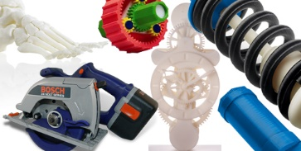
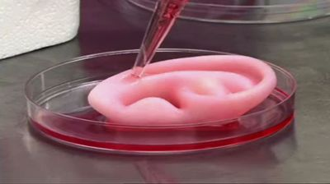
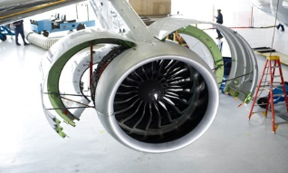
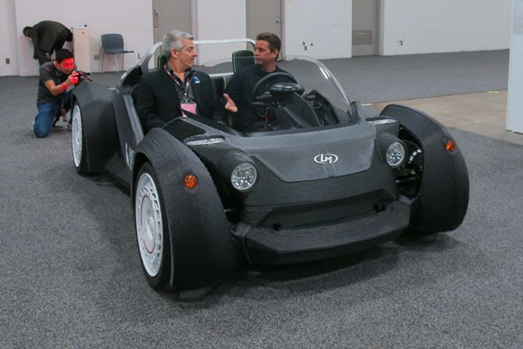
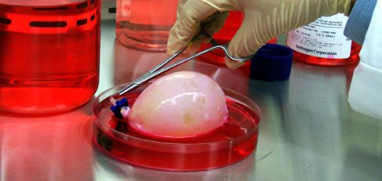
Today
Notes:
As you will see modern day additive manufacturing spans many industries and has been adapted to fit a variety of business requirements. From rapid prototyping of complex parts and prosthetics to the creation of fully functional human blood vessels and organs such as bladders. The additive sciences have truely transformed manufacturing.
In 2003 Surgeon Anthony Atala engineered a new bladder using the Luke Massellais own cells and performed the successful transplant. Today Luke is a healthy 20 year old college student enjoying a normal life.

Slide 11
Political and Legal Influences
Anthony Meunier
DeVry University
Team E
Notes:
Hello, my name is Anthony Meunier and in this portion of the presentation I will be focusing on the political and legal influences associated with additive manufacturing, followed by some important economic questions and considerations as they apply to the technology.

Slide 12
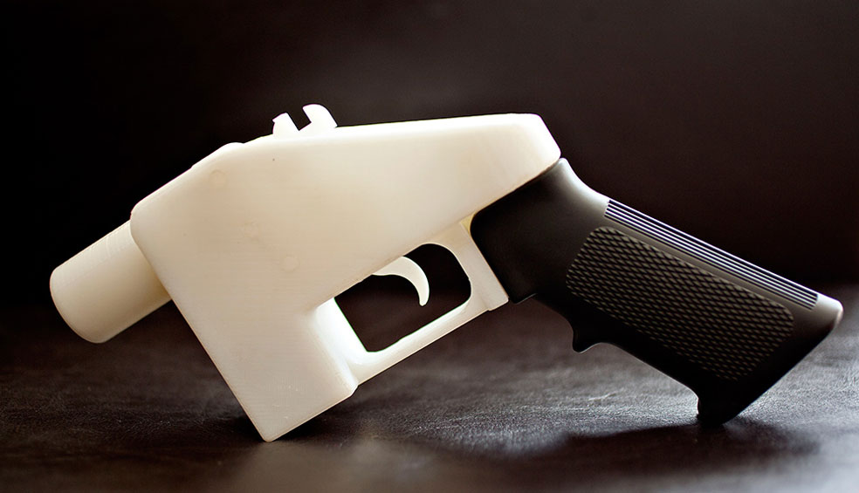
Gun Control Loopholes and Challenges To Safety
Liberator pistol first 3-D printed gun
Design files made publicly available via Internet
Bypasses traditional processes (background check, waiting period) of buying firearms
Notes:
Perhaps one of the biggest and most easy-to-cite issues regarding 3-D printing and the legal realm is gun control. The famous case of the Liberator pistol, also known as the Wiki Weapon, was brought to the forefront of public attention upon its “release” on May 5, 2013. 4 days later the United States Department of Defense ordered the take down of the design files for the Liberator, citing a possible violation of the International Traffic in Arms Regulations. Many close to and familiar with the situation have claimed that there was much more pressure from the government than just the stated violation of Arms Regulations, but nevertheless Defense Distributed, the creators of the Wiki Weapon, voluntarily complied to take the files down to avoid further government pressure. It’s pretty obvious to anyone in the general public the issue that this poses from not only a policy-making and regulation viewpoint, but also the challenges posed to general public safety. Typically there are set processes involved in purchasing a firearm, such as background checks and a waiting period; printing your own firearm theoretically negates all those processes and empowers anyone with a 3-D printer and the design files to create a physical, working firearm… which is a pretty scary thought.

Slide 13

Government Regulation
Hands-on or hands-off approach?
Legislative and judicial influence
Establish industry norms
Promote innovation
Notes:
There are many facets to law that directly affect or will be influenced by the 3-D printing revolution; environmental law, product liability law, contract law and even criminal law are just a few of the areas that must be considered, and an attempt at defining these laws and their application to the technology is sure to be a rising point of contention as the 3-D printing boom takes center stage in ushering in this potential new Industrial Age. As many of you know, government processes are typically slow and convoluted. The government ultimately dictates the “law of the land,” and these laws are aimed at protecting the safety and well-being of society as a whole. Any new technology needs to be governed in some sense, especially when the impact is as extensive as 3-D printing has the capability to be. There needs to be a balance between keeping us as a society safe while not stifling innovation of the technology. Many feel that hands-on government intervention such as creating all new legislation would ultimately slow the rate of progress and innovation that 3-D printing is currently experiencing in this golden age of progress and popularization of the technology. Instead of creating completely new legislation, the lesser of two evils, so to speak, would be letting the judicial system oversee critical legal issues the technology poses on a case-by-case basis. In addition, looking to the additive manufacturing industry is a good starting point in building some form of self-regulation, as the industry itself can have large control over the processes of creation the printers use as well as what objects are ultimately able to be created from the devices. This would enable continued start-up and progress NOW while it’s critical to the success or failure of the technology as a whole, and handle many of the issues later on as they come, rather than disallow progress before it’s even had a chance to begin.

Slide 14

Intellectual Property
Patents dictate creation process
“Open-source” fuels principle behind 3-D printing
Who is liable in cases of infringement?
3-D printing process/mechanism variation
Notes:
“Intellectual property” is a term that’s very encompassing, yet very vague in specific context, especially in this day and age of the Internet and the ability to share everything, instantly. 3-D printing poses as much, if not more, intellectual property issues than the Internet itself because not only does it fully utilize the principles of “open-source” and “user-shared” via use of the Internet, it gives these users the ability to produce physical products from this sharing of ideas and designs – not all of which may be genuinely original, unique intellectual properties. From simple objects such as plastic parts used in machines to detailed three-dimensional models of very well-known, licensed products like the character Yoda from the popular movie series “Star Wars,” additive manufacturing by way of 3-D printing is capable of producing a wide-range of physical products. Most importantly, these physical products can be created by a home-user who can then theoretically mass-produce them fairly easily with the proper design files and raw materials. One of the fundamental points of contention for 3-D printing and intellectual property concerns come in the form of patents and the large effect they have on the entire 3-D printing process. With users having the ability to produce patented products at home (such as Yoda), there is clearly a disconnect in ownership of ideas and strength of the patent system. This leads to the question of how infringement issues will be handled. Is the maker of the design file or the user of the file liable? Only time will tell through the motions of the legal system, but there can be very easy solutions to the issue. One solution that glaringly stands out is to simply have the industry giants who claim ownership to many of the patents and copyrights associated with popular products monetize the digitization of their products. By doing so, these companies can both make money from 3-D printing while encouraging the use and growth of the technology. Another, more subtle aspect, of patents and their effect on the additive manufacturing industry is the actual hardware methods that the 3-D printers themselves use. From Stereolithography, to Selective Laser Sintering, to Laminated Object Manufacturing and everything in between, there are many different processes and mechanisms that can be used to achieve manufacturing by addition of products. This is one point that 3-D printers can ride to future success. By using varying mechanisms and technologies within the printers, many patents can essentially be bypassed since the language of them was not created with these manufacturing processes in mind.

Slide 15
Economic Questions and Considerations
Anthony Meunier
DeVry University
Team E

Slide 16
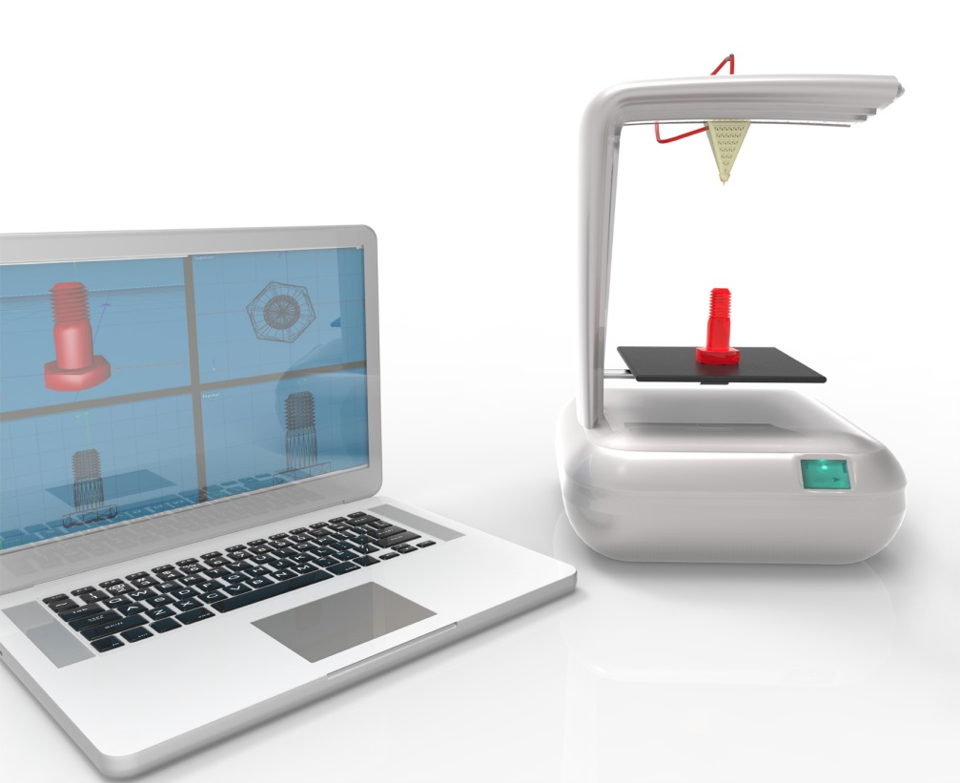
Shift in World’s Manufacturing Processes
“Counter-top creators”
Think globally, produce locally
Shift from manual labor to highly skilled and trained technical
May likely cause change in global production centers and established economics
Notes:
Just as the industrial revolution of the last 200 years brought about significant changes to manufacturing processes and ultimately set forth the economy we know today, many of the changes and opportunities the 3-D printing technology can offer will end up revolutionizing production standards and spark a new economic structure. With a projected 390% market growth over the next seven years, 3-D printing is well on it’s way to realizing it’s potential as a wide-spread method of manufacturing and production. The notion of “do it yourself” will come full circle with 3-D printing’s ability to provide the user, the creator, and the inventor all with a fairly easy way to produce tangible products. While mass production in the context we know it won’t disappear entirely, it will be altered and affected somewhat by the capability of 3-D printers. Additive manufacturing technologies are currently not fast enough to achieve production on the scale that factories do. But again, what they do offer is something entirely new; a way for the average person to produce, without the need for the factory. In addition, the ability to highly customize and create situationally-unique products is an area that is lacking in the mass production of factories. One interesting tie-in of these two production methods is the fact that 3-D printers can actually create many of the parts, such as raw plastics, needed by machines that are used in mass production. In this way they can complement each other. In cases of additive manufacturing being used commercially, the middleman can be almost entirely cut out. Imagine an aircraft company. Now imagine an aircraft company with the capability to produce spare parts on demand via use of an in-house 3-D printer. In this context, a highly skilled engineer can design the blueprint files used to create each of these parts and they can be physically made on-demand, on location. This reduces reliance on availability of outside products and eliminates excess holding stock, which all around increases profitability and efficiency; both of which are key in economics. Imagining this scenario in practice, you can begin to see a shift from highly manual labor such as using tools to bend and meld materials to specification to instead using technical design processes to create the blueprints and fabrication from raw materials that the machine then handles. From this we may envision a world in which large scale, manual production (such as what we see in China) is slowly supplemented and even replaced by highly skilled engineers and operators, which obviously would initiate a rebalance in the world’s production centers.

Slide 17
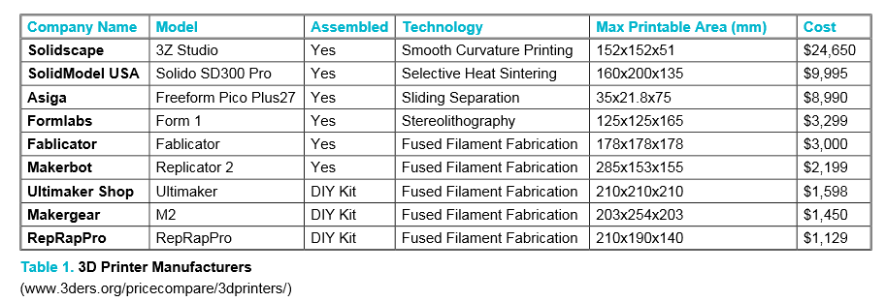
Associated Cost of 3-D Printers
Models and cost vary by intended application and complexity of output
Hardware is largest cost barrier to entry; still allows production without need for expensive infrastructure
Capacity to use recycled materials may be tipping point
Notes:
Here is an informational chart from 2014 that shows a list of some of the most popular 3-D printing manufacturers and their models. On the chart we can see some important information about the actual printers, such as if it comes assembled or if it is a DIY kit, what type hardware technology is used within the machine (this references what I mentioned earlier about processes and mechanisms within the devices), the max printable area in millimeters that each device can achieve (this determines the maximum size of the finished product), and of course most importantly the cost of the machine.
The fact that just in this list there is such a wide price variance between the most expensive and least expensive machine illustrates that there are many factors that go into the machines, perhaps most notably the “technology” that each machine uses to achieve it’s additive manufacturing process. This largely determines the cost difference in these machines, as the technology used to do the printing has a big impact on aspects such as detail, complexity, and accuracy.
3-D printers abilities to use raw materials bodes well for the technology’s future success and allows the machines to gain a distinct advantage over their industrial production counterparts in that they are increasingly able to use recycled materials. In addition to production capabilities without the need for a costly factory or equivalent, the ability to potentially save money by using recycled materials could help overcome the initial cost barrier of buying the actual machine and help set additive manufacturing ahead in terms of efficiency and cost.

Slide 18
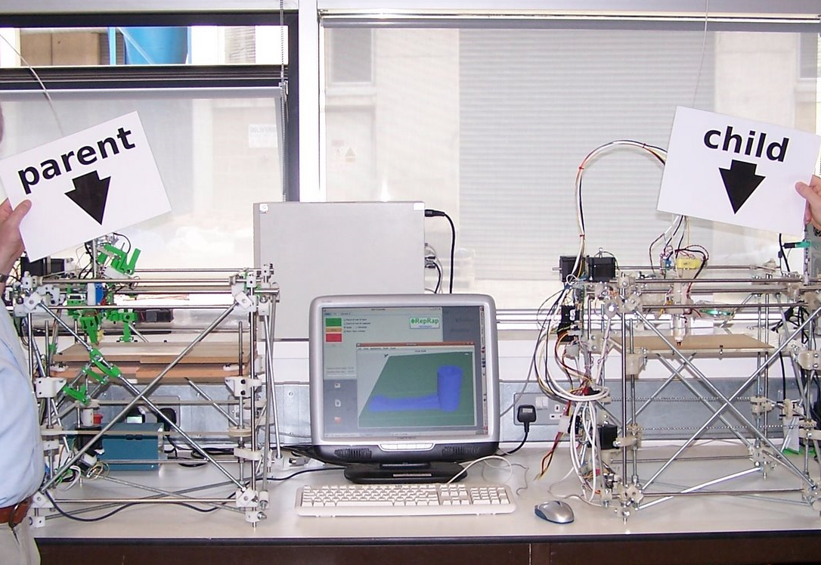
RepRap Project
Can print all of the components to make itself
One of the cheapest 3-D printers due to self-replicating ability
Self-sustainable and low entry costs
Forerunner in using recyclable materials
Notes:
Perhaps the shining point in 3-D printing and it’s ability to carry us into the future, in many contexts, is the RepRap Project. With its first model released in 2007, the RepRap is a unique project in 3-D printing because its goal was, and is, to be able to completely produce the components required to create itself. As you can see in the included picture, the “parent” RepRap on the left successfully created all of the components used to make the “child” RepRap on the right. This is a revolutionary concept and speaks volumes for operating cost of additive manufacturing by way of 3-D printing. The RepRap is extremely cost-effective not only in terms of hardware but also in terms of continued operating cost because it is very efficient in terms of using recyclable materials. Like anything else, low entry and low operating costs give the RepRap a unique ability to bring 3-D printing to the masses. Since it’s release, the RepRap has benefited from numerous model improvements and it’s increasingly low cost and efficiency have been influential on the rest of the industry, which helps self-regulate and better the additive manufacturing industry as a whole. RepRap as an example of a self-replicating machine indicates just how impactful 3-D printing technologies may in fact be to manufacturing and transitively the world economy, and perhaps gives most credence to the notion that additive manufacturing by way of 3-D printing is in fact the next industrial revolution.

Slide 19
Environmental Impact and Cultural Context
Tim Messink
DeVry University
Team E

Slide 20
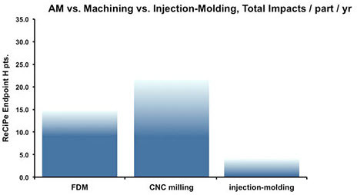
Environmental Impact
Life Cycle Assessment
climate change ozone depletion acidification eutrophication toxicity ionising radiation health damage due to PM (Particulate Matter Intake) and Ozone land-use water depletion mineral resource depletion fossil fuel depletion
Notes:
LCA is the systematic evaluation of categories such as climate change, health damage from inhaling particles from the manufacturing process, land use for waste, and depletion of resources.
Based on the R-E-H score, traditional injection molding has the least negative impact on the environment compared to Fusion Deposition Modeling.
CNC Milling being the worst offender is likely due to the fact that this is a subtractive process, and materials removed to form parts need to be recycled or disposed of which is costly on many levels.
The environmental impact of the additive process depends heavily on the composite material used in the building process as well as the efficiency of the laser technology used.
A study at the Robert Morris University in Pennsylvania found that materials such as photopolymers which are used for rapid prototyping contain up to 100 times more toxic heavy metals than polyethylene based materials.
The rapid growth of additive manufacturing has resulted in no clear mandates about the filtration or exhaust accessories that should be sold with such printers, which means users are likely already exposed to serious health hazards.

Slide 21
Cultural Impact
Manufacturing
Consumer
Education
Global
Notes:
Additive manufacturing is seen as a disruptive technology within the manufacturing industry. The new 3D market will likely displace many aspects of manufacturing processes. This paradigm shift could phase out smaller manufacturing facilities unable to afford the new technology while larger manufacturing facilities will retool the workforce with the needed technical expertise to manage the shop floor.
Consumers will enter a self-manufacturing paradigm, allowing people to download digital product designs and print products on demand. This emerging process will result in changes to consumer purchasing and consumption habits.
From an educational standpoint, we will continue to see an accelerated need for highly skilled technical personnel in the fields of engineering, CAD software and programming as 3D printers continually become more affordable.
Global innovation will rise from the growth of an ecosystem for the sharing of digital designs in sites like Thingiverse, a 3D printing repository where 3D printing enthusiasts can share work and improve on concepts in the market place. Unfortunately as products become digitally available for print, the lines will continue to blur regarding intellectual property and patent infringement as the global workforce shifts from manual labor to digital labor.
Additionally, as with many rapidly advancing technology's, environmental policy tends to move into a reactive mode to protect resources and address health concerns.

Slide 22
Moral and Ethical Implications
Aseelah Muhammad
DeVry University
Team E

Slide 23


Ethics and Morals of 3D PRINTING
Notes:
Ethics are being in accordance with the rules or standards for right conduct or practice, especially the standards of a profession. 3D printing is a relatively new profession and conduct and practice rules haven’t been created yet. So what does ethics mean to 3D Printing?

Slide 24

IS IT MORAL TO PRODUCE ORGANS TO SAVE A LIFE?
PATENTS AND COPYRIGHTS
Notes:
COPYRIGHTLAW ALLOWS FOR “PARELLEL CREATION”. PATENTS DO NOT.
IT MAY BE DIFFICULT TO AVOID INADVERTENT PATENT INFRINGEMENT.
WILL BE EASY TO COPY EXISTING COMMERCIAL PRODUCTS.

Slide 25
Conclusion
Tim Messink
DeVry University
Team E

Slide 26
Conclusion
Additive Manufacturing Process pervasive impact:
Traditional manufacturing.
All phases of supply chain.
Evolution across all industries.
Resource consumption.
Consumer purchasing and consumption habits.
Notes:
The pervasive impact that the additive manufacturing process may have on society appears to eclipse any industrial revolution in the last two centuries. As 3D printing continues to evolve in the aviation, automotive, biomedical and regenerative medicine industry, we may see a paradigm shift towards manufacturing by design with a profound impact on each phase of the supply chain, resource consumption, the entire production process down to the transportation and consumption of products.

Slide 27
References
3D Printer Manufacturers [Online image]. (2014). Retrieved from http://eds.a.ebscohost.com.proxy.devry.edu/eds/pdfviewer/pdfviewer?vid=4&sid=39f16416-6e53-429b-acea-2d7aaa6a08ca@sessionmgr4004&hid=4111
Carter, M.T. (Photographer). (2013, November 11). The Liberator pistol [Online image]. Retrieved from http://designandviolence.moma.org/the-liberator-by-defense-distributed/
Davin, K. (2013, June 19). 3D Printing Is Bringing Big Changes to Manufacturing. Retrieved from http://info.cassidyturley.com/commercial-real-estate-cincinnati-blog/bid/299250/3D-Printing-Is-Bringing-Big-Changes-to-Manufacturing
First replication [Online image]. (2009). Retrieved from https://commons.wikimedia.org/wiki/File:First_replication.jpg#metadata

